Slide 1
Topological sorting

Slide 2
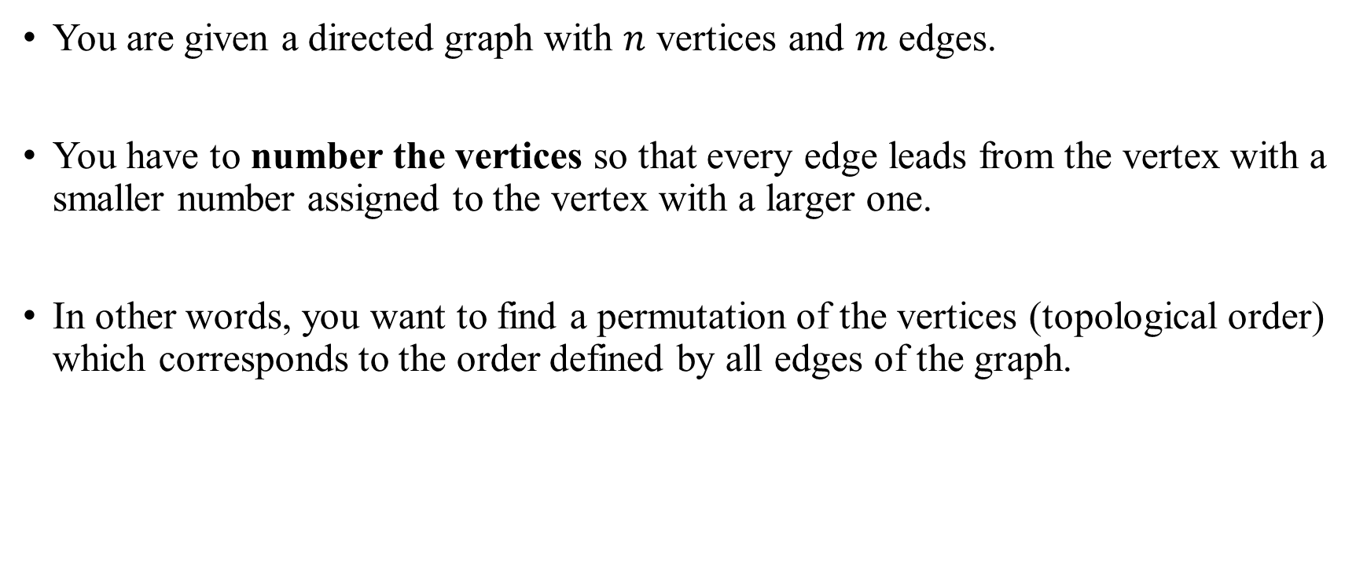
Topological sorting
You are given a directed graph with $n$ vertices and $m$ edges.
You have to number the vertices so that every edge leads from the vertex with a smaller number assigned to the vertex with a larger one.
In other words, you want to find a permutation of the vertices (topological order) which corresponds to the order defined by all edges of the graph.

Slide 3
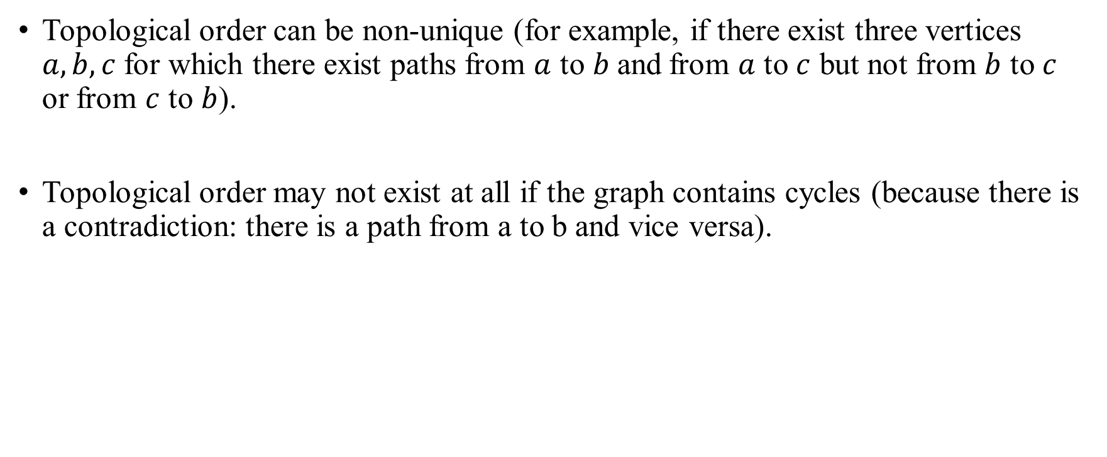
Topological sorting
Topological order can be non-unique (for example, if there exist three vertices $a, b, c$for which there exist paths from $a$ to$b$and from $a$ to $c$ but not from $b$ to $c$ or from $c$ to $b$).
Topological order may not exist at all if the graph contains cycles (because there is a contradiction: there is a path from a to b and vice versa).

Slide 4
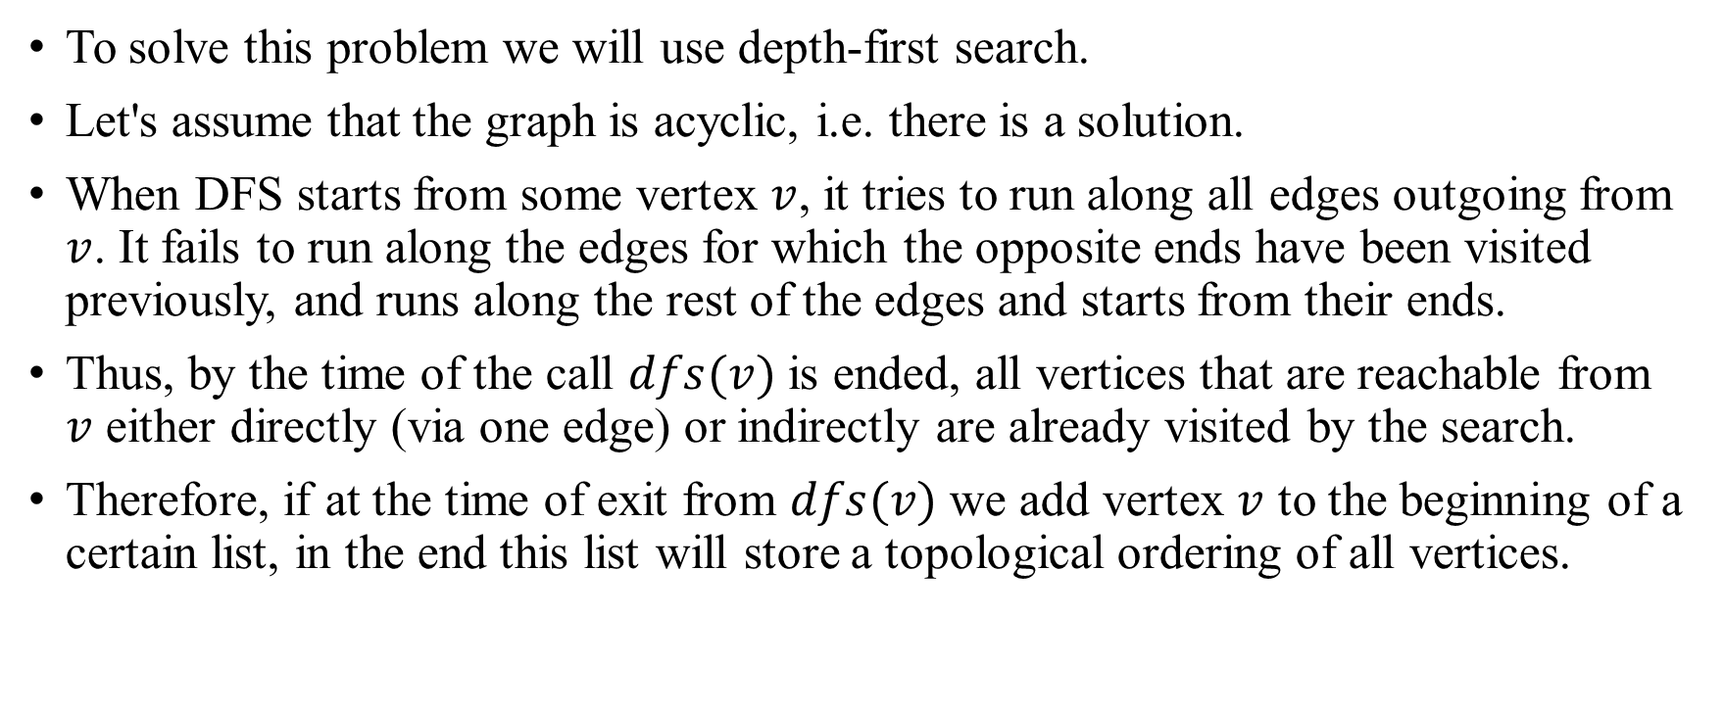
Topological sorting Algorithm
To solve this problem we will use depth-first search.
Let's assume that the graph is acyclic, i.e. there is a solution.
When DFS starts from some vertex $v$, it tries to run along all edges outgoing from $v$. It fails to run along the edges for which the opposite ends have been visited previously, and runs along the rest of the edges and starts from their ends.
Thus, by the time of the call $dfs(v)$ is ended, all vertices that are reachable from $v$ either directly (via one edge) or indirectly are already visited by the search.
Therefore, if at the time of exit from $dfs(v)$ we add vertex $v$ to the beginning of a certain list, in the end this list will store a topological ordering of all vertices.

Slide 5
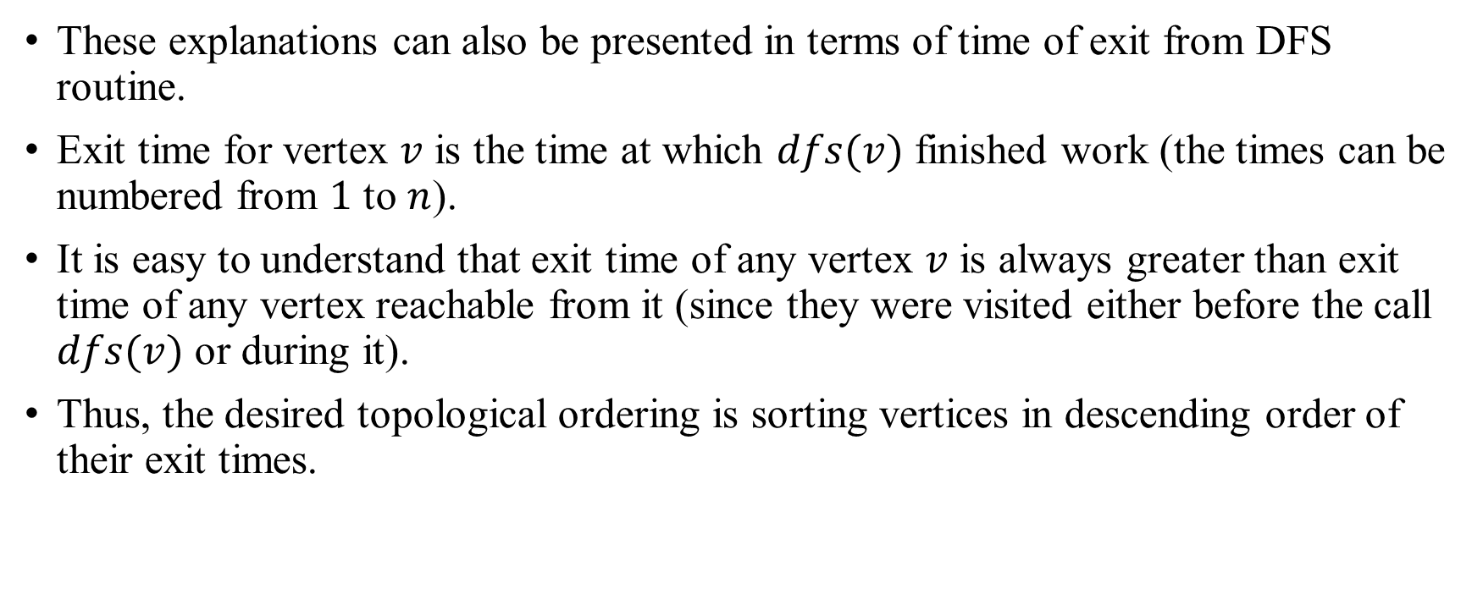
Topological sorting Algorithm
These explanations can also be presented in terms of time of exit from DFS routine.
Exit time for vertex $v$ is the time at which $dfs(v)$ finished work (the times can be numbered from $1$ to $n$).
It is easy to understand that exit time of any vertex $v$ is always greater than exit time of any vertex reachable from it (since they were visited either before the call $dfs(v)$ or during it).
Thus, the desired topological ordering is sorting vertices in descending order of their exit times.

Slide 6
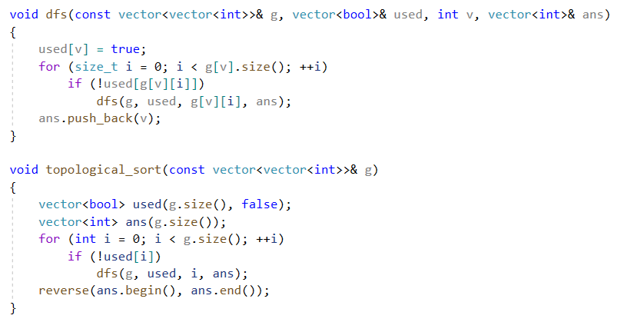
Topological sorting Implementation

